Slide 1



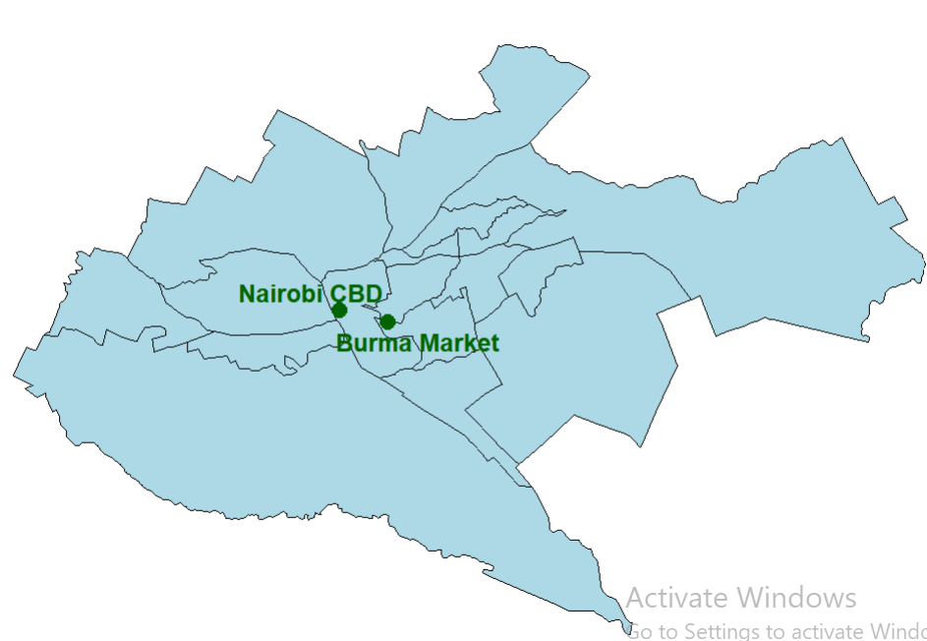
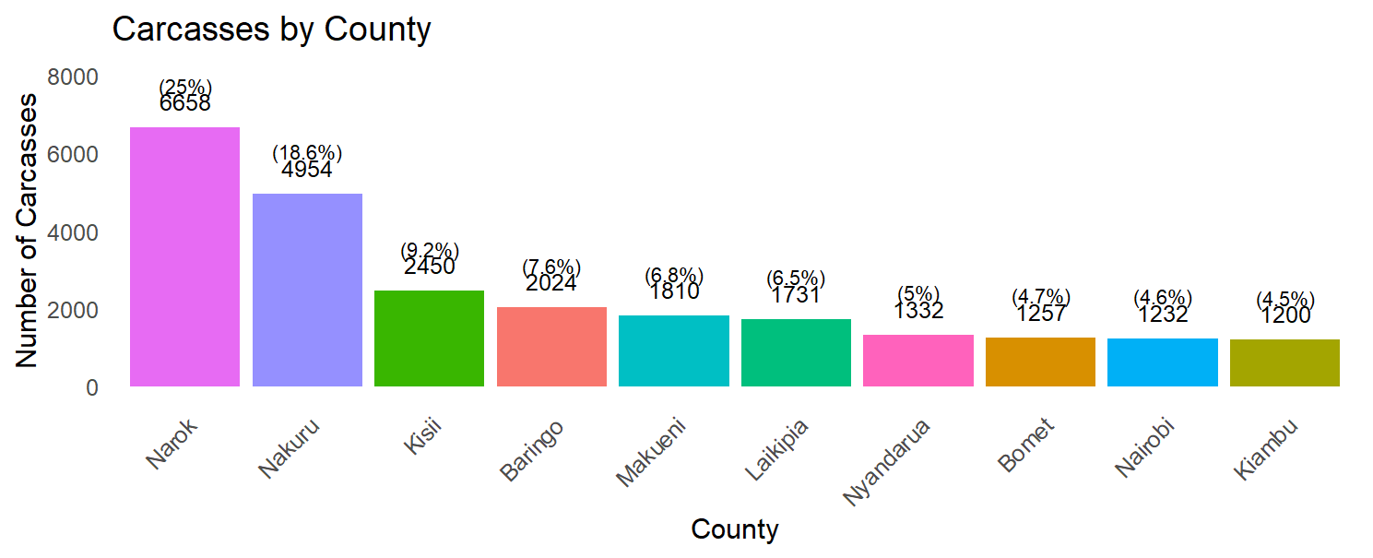
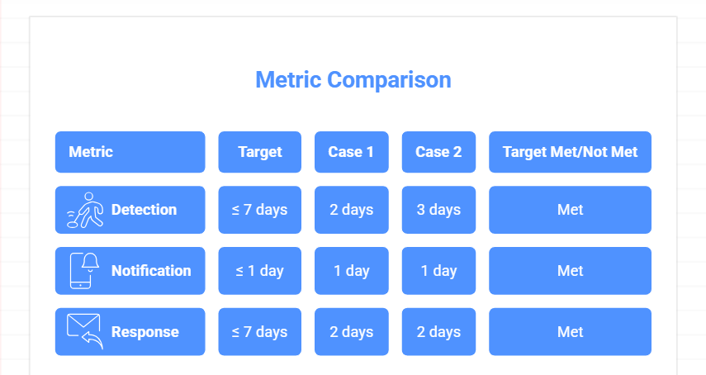
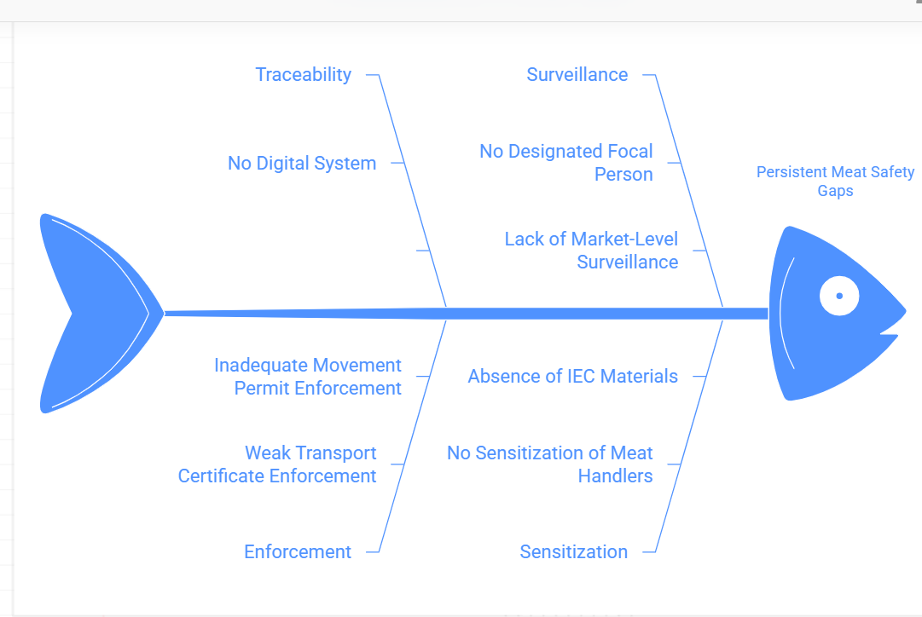


Recurrent Cutaneous Anthrax Outbreak among Meat Handlers in Shauri Moyo (Burma) Market, Nairobi County, Kenya, February 2026: A One Health
S.Maragia¹ , J.Githuku¹,O. Kaburu¹, I. Mueni¹,S. Kamama¹, I.Yussuf¹ , T. Gitonga², P. Lokamar³
1: Field Epidemiology and Lab Training Program, Kenya. 2:National Public Health Laboratory, Kenya ³Zoonotic Disease Unit, Kenya
BACKGROUND
Anthrax is endemic in Kenya due to persistent environmental spores
Burma Market, established in the 1980s, is Kenya’s largest meat market, selling over 3,000 cattle daily
Human infection occurs mainly through handling infected animals, and a confirmed case occurred in Burma market market in November 2025
A suspected case was reported on February 2026.
OBJECTIVE:
To investigate a recurrent anthrax outbreak, identify exposure pathways, and assess response gaps using a One Health approach.
STUDY DESIGN AND SAMPLING:
Design:
Descriptive cross‑sectional outbreak investigation
Case Definition
Suspected: Compatible cutaneous lesion
Confirmed: Laboratory-confirmed Bacillus anthracis
Data Collection
Active case finding in 2 health facilities (Kaloleni Health Services and Kaloleni Dispensary)
Key informant interviews of surveillance officers and market management
Veterinary surveillance data review
Carcass origin tracing by county
Analysis
Descriptive analysis using R
Supply chain mapping
Timeliness assessment using 7-1-7 framework
METHODOLOGY:
.
STUDY AREA: Shauri Moyo (Burma) Market, Nairobi County, Kenya
Figure 1 : Map of Nairobi county with Burma market and Nairobi CBD labelled
RESULTS
Two PCR‑confirmed cutaneous anthrax cases in male meat handlers, ages 22 and 42.
Both presented with characteristic eschars on hands/forearms.
Both notified within 1 day and recovered fully after treatment.
Figure 3 : Distribution of carcasses by county to Burma market (Nov 2025 – Jan 2026, N=26,632 carcasses
Figure 1: Summary of 7-1-7 framework implementation of the outbreak
DISCUSSION
Figure 2: Root cause analysis of the cause of persistent meat safety gaps
Two PCR‑confirmed cases demonstrating an ongoing meat handler exposure to infected carcasses.
As the largest meat market in Kenya, Burma Market receives over 26,000 carcasses from at least ten counties; this geographically diverse supply chain creates multiple points of potential zoonotic introduction, positioning the market as a high-risk epicentre for re‑outbreak.
Although response timeliness met 7-1-7 targets, systemic weaknesses persist, enabling recurrence
CONCLUSIONS
Two PCR‑confirmed cutaneous anthrax cases in male meat handlers, ages 22 and 42. Both presented with characteristic eschars on hands/forearms. Both were notified within one day and recovered fully after treatment.
The market’s geographically diverse supply chain and with structural gaps in traceability and coordination create multiple introduction points, sustaining transmission cycles.
systemic under‑detection of animal cases and weak inter‑sectoral collaboration underscore the urgent need for a One Health approach to break recurrence.
Contact: maragiasimon21@gmail.com

